Slide 1
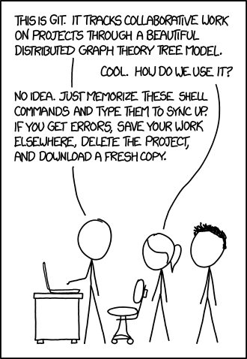
Git Basics
init, commit, add, clone, push, pull

Slide 2
The plan…
Glossary
repository | set of files/directories under version control
clone | make a local copy of a GitLab repository
fetch / status / show / log | get info about your repository, and compare to the GitLab version
add | add changes to the staging list
commit | locally store a set of repository changes
push | upload changes from the local repository version to GitLab
pull | download changes from the GitLab repository to your local repository
remove | remove a local file & remove it from local version control
clean | remove any local untracked files
reset | restore the local repository to a particular version
conflict | local and GitLab changes to the same file(s)! Help!
Setup a GitLab repository
Clone the GitLab repository
Getting info your repository
Add something new to the repository
Push local changes to GitLab
Collaborative projects and pulling changes from GitLab.
Group task.

Slide 3
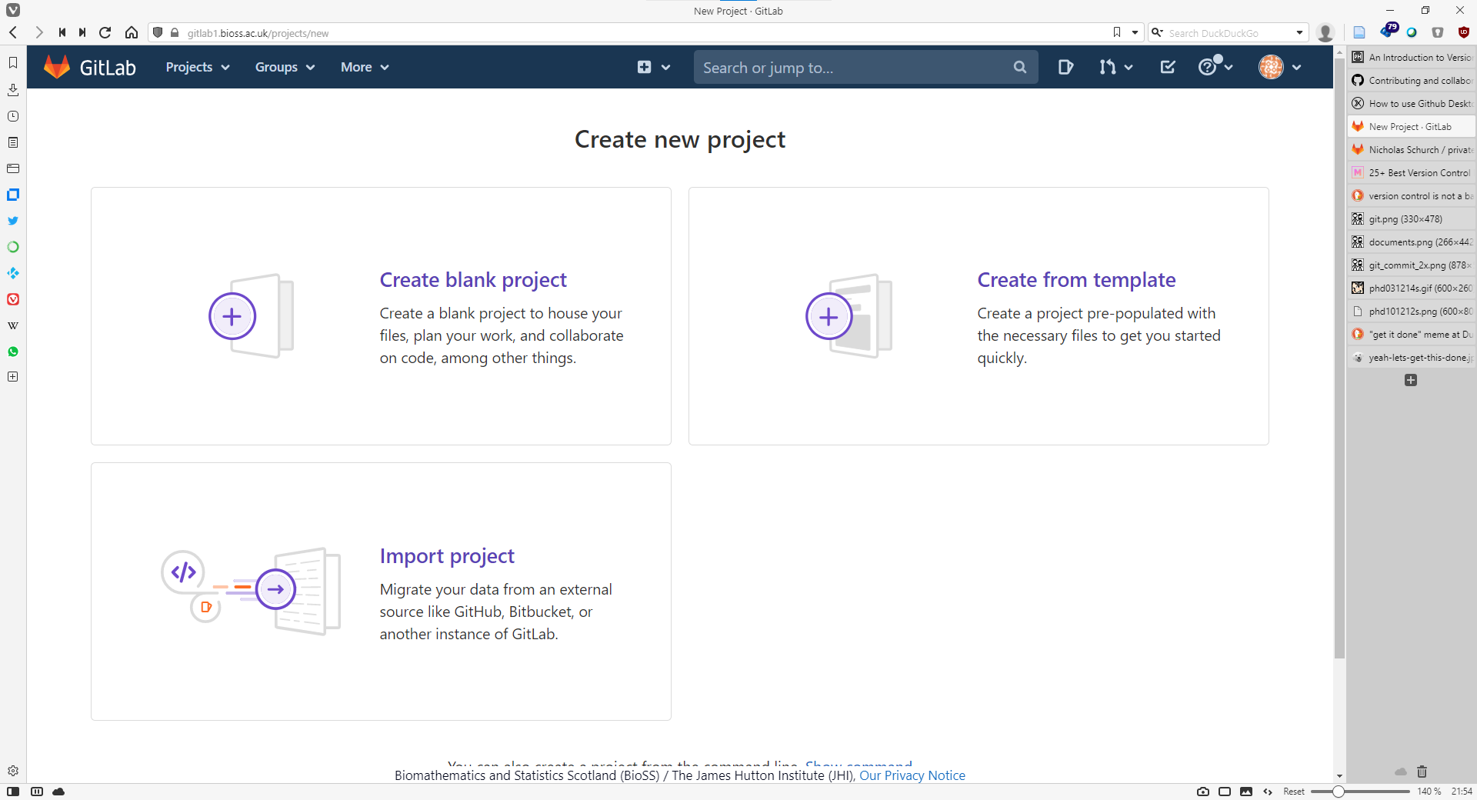
1. Setup a GitLab repository
click this

Slide 4
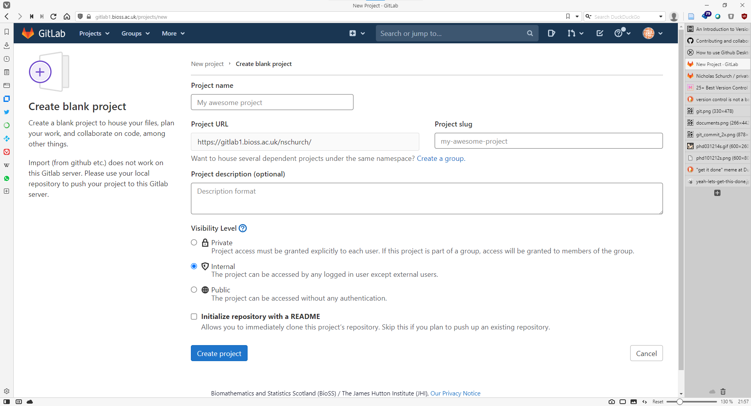
1. Setup a GitLab repository
fill in these
click this

Slide 5
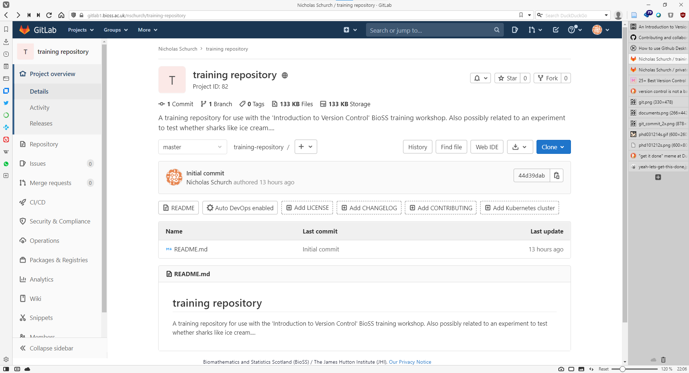
1. Setup a GitLab repository
name and visibility
breadcrumbs
quick details
description
branch
add things
see history of changes
latest activity

Slide 6
1. Setup a GitLab repository
sidebar of goodies
repository dataset (files and directories)
content of the README.md file

Slide 7
1. Adding a license
choose a license for your set of data

Slide 8
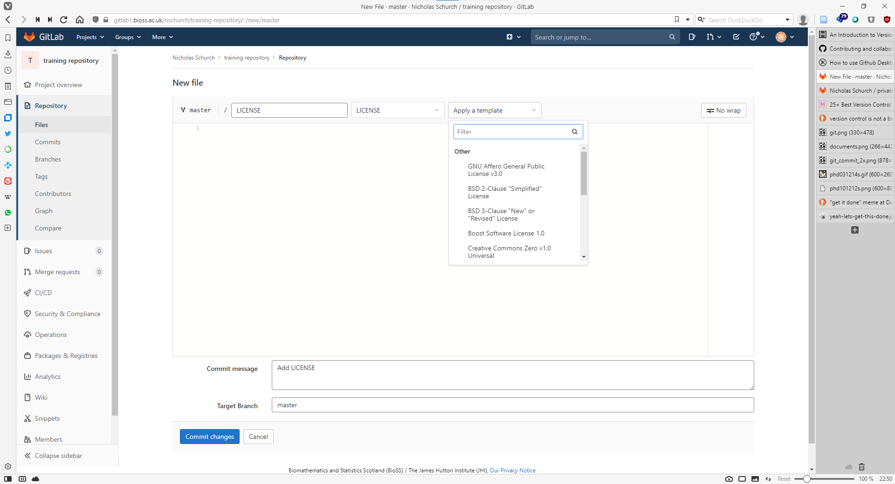
1. Adding a license
choose from a pre-existing template
add the text of a different license here
Important rule: every commit must have a comment with it!
add a commit comment in here
click this

Slide 9
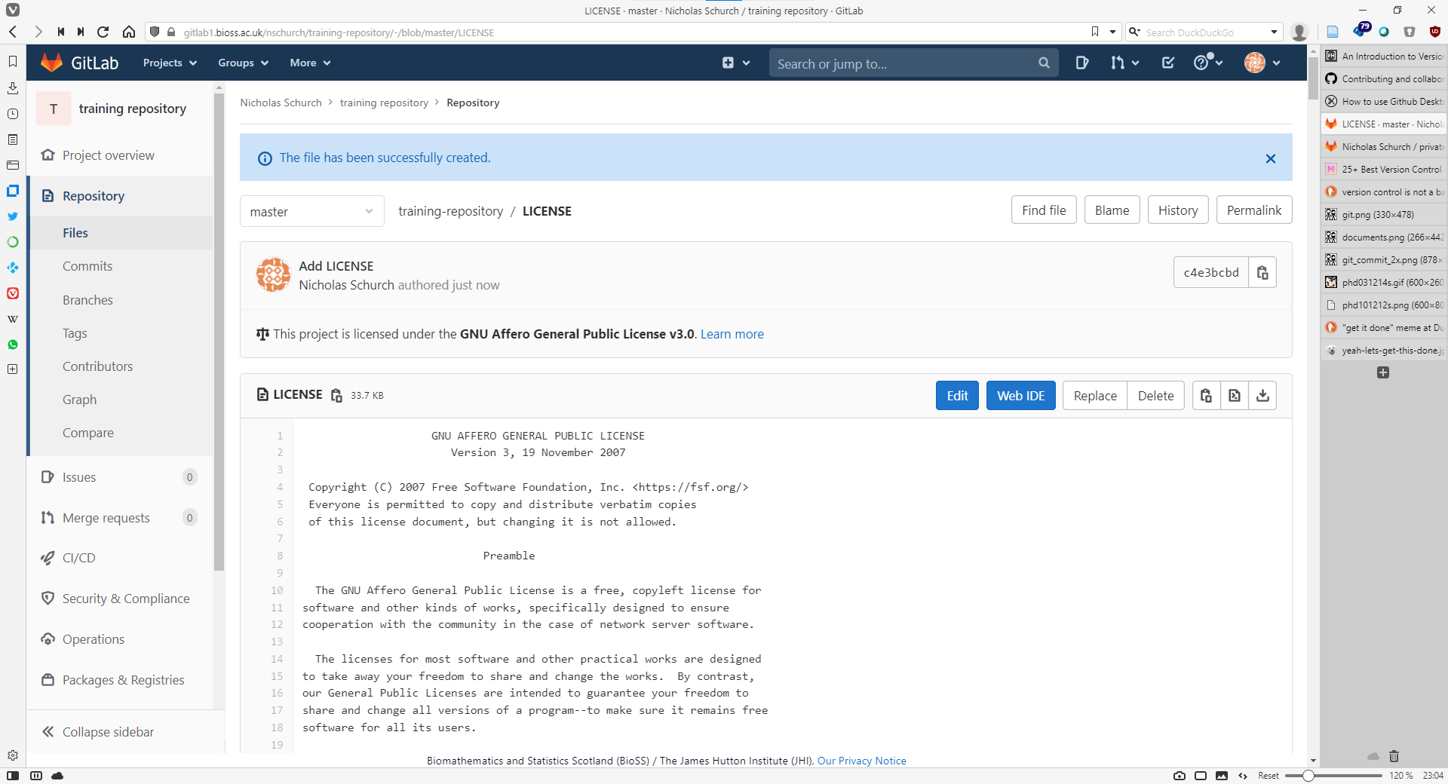
1. Adding a license
click this
success!

Slide 10
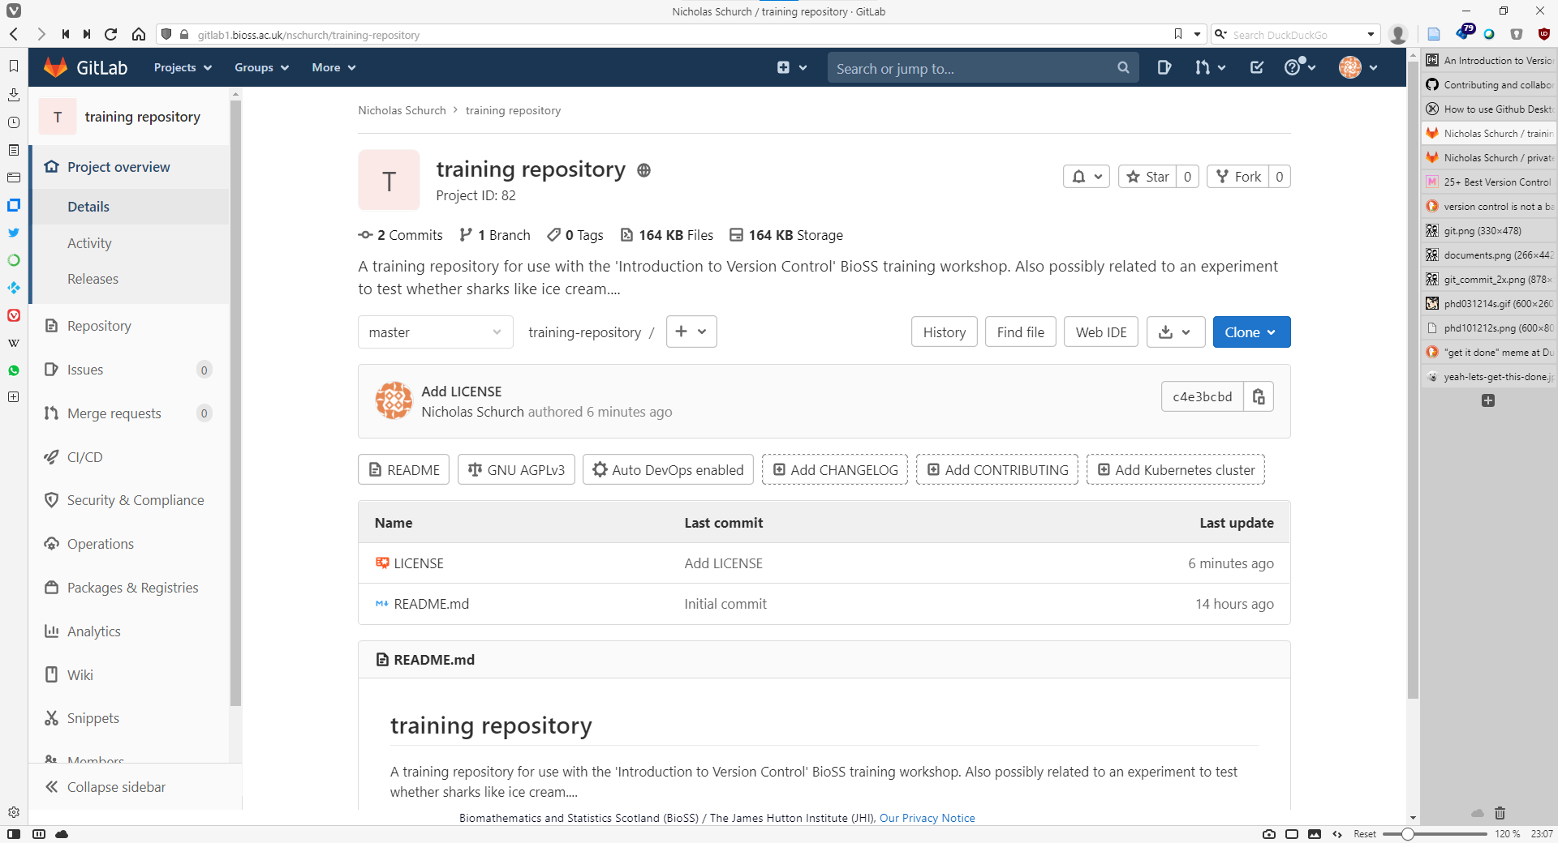
1. Adding a license
updated activity
new license file

Slide 11
2. Cloning the GitLab repository
Glossary
repository | set of files/directories under version control
clone | make a local copy of a GitLab repository
fetch / status / show | get info about your repository, and compare to the GitLab version
add | add changes to the staging list
commit | locally store a set of repository changes
push | upload changes from the local repository version to GitLab
pull | download changes from the GitLab repository to your local repository
remove | remove a local file & remove it from local version control
clean | remove any local untracked files
reset | restore the local repository to a particular version
conflict | local and GitLab changes to the same file(s)! Help!
myfile.txt
v1
Remote
clone
Local
myfile.txt
.git
v1

Slide 12
2. Cloning the GitLab repository
$ git clone <url>
$
$ git clone https://gitlab1.bioss.ac.uk/nschurch/private-training-repository.git
Cloning into 'private-training-repository'...
Username for 'https://gitlab1.bioss.ac.uk': nschurch
Password for 'https://nschurch@gitlab1.bioss.ac.uk’:
remote: Enumerating objects: 13, done.
remote: Total 13 (delta 0), reused 0 (delta 0), pack-reused 13
Receiving objects: 100% (13/13), 2.57 MiB | 9.75 MiB/s, done.
Resolving deltas: 100% (1/1), done.
$

Slide 13
2. Cloning the GitLab repository
click this
click this
Notes:
Note, you can also add ssh keys to gitlab so you don’t have to use your username and password all the time!

Slide 14
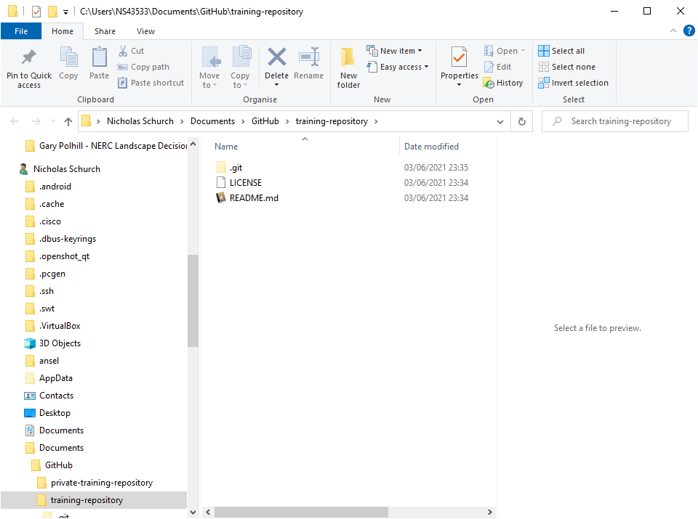
2. Cloning the GitLab repository
local repository path
hidden directory there git does it magic!
don’t mess with this
repository files and directories

Slide 15
3. GitLab repository info
Glossary
repository | set of files/directories under version control
clone | make a local copy of a GitLab repository
fetch / status / show / log | get info about your repository, and compare to the GitLab version
add | add changes to the staging list
commit | locally store a set of repository changes
push | upload changes from the local repository version to GitLab
pull | download changes from the GitLab repository to your local repository
remove | remove a local file & remove it from local version control
clean | remove any local untracked files
reset | restore the local repository to a particular version
conflict | local and GitLab changes to the same file(s)! Help!
myfile.txt
v1
Remote
fetch /status / show / log
Local
myfile.txt
.git
v1

Slide 16
3. What was the last commit?
$ git show
commit dbdb0bff1eca5d7bc2104dab639715fc0e01facb (HEAD -> master, origin/master, origin/HEAD)
Author: Nick Schurch <nick.schurch@bioss.ac.uk>
Date: Fri Jun 4 08:05:55 2021 +0100
Added a copy of the Git Basics training presentation
diff --git a/presentations/the_basics.pptx b/presentations/the_basics.pptx
new file mode 100644
index 0000000..545fd1d
Binary files /dev/null and b/presentations/the_basics.pptx differ
$

Slide 17
3. Show me all the history!
$ git log
commit 66f72539a756c8d9aa57f97a27ab888ce3e7be7e
Author: Nick Schurch <nick.schurch@bioss.ac.uk>
Date: Tue Apr 12 22:56:29 2022 +0000
Update README.md
commit 909fda6cde46ba005997d069569300ec2ec17620
Author: Nick Schurch <nick.schurch@bioss.ac.uk>
Date: Tue Apr 12 12:59:31 2022 +0100
Added new file.
<snip>
$ git log --pretty=format:"%h - %an, %ar : %s"
c7334d4 - Nick Schurch, 10 hours ago : Merge branch 'nickschurch-master-patch-84836' into 'master'
66f7253 - Nick Schurch, 10 hours ago : Update README.md
909fda6 - Nick Schurch, 21 hours ago : Added new file.
dbdb0bf - Nick Schurch, 10 months ago : Added a copy of the Git Basics training presentation
2aef3c4 - Nick Schurch, 10 months ago : Add CONTRIBUTING
9a3da20 - Nick Schurch, 10 months ago : Add LICENSE
d8799d9 - Nicholas Schurch, 10 months ago : Update README.md
$

Slide 18
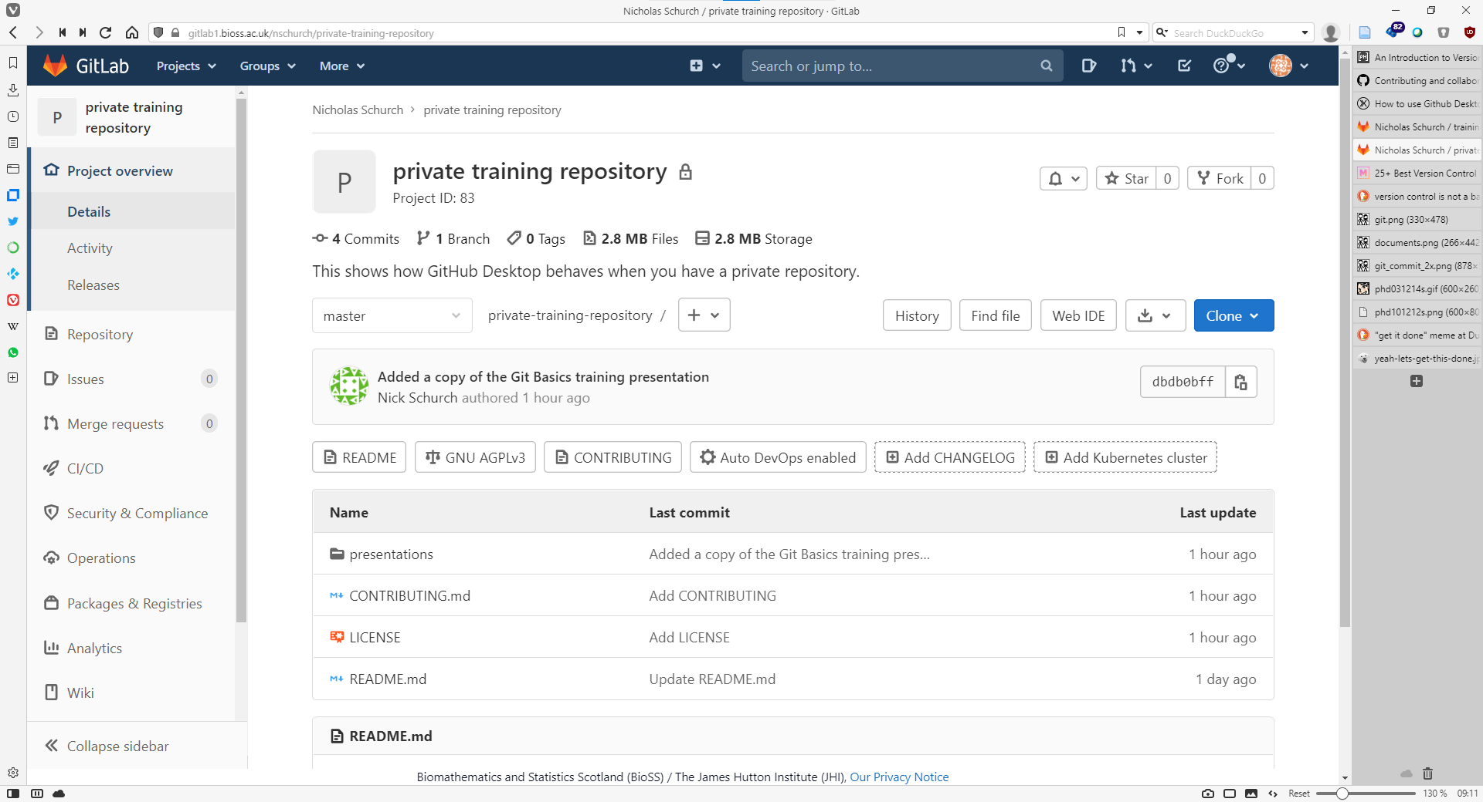
3. GitLab Repository history
History information is available in GitLab here

Slide 19
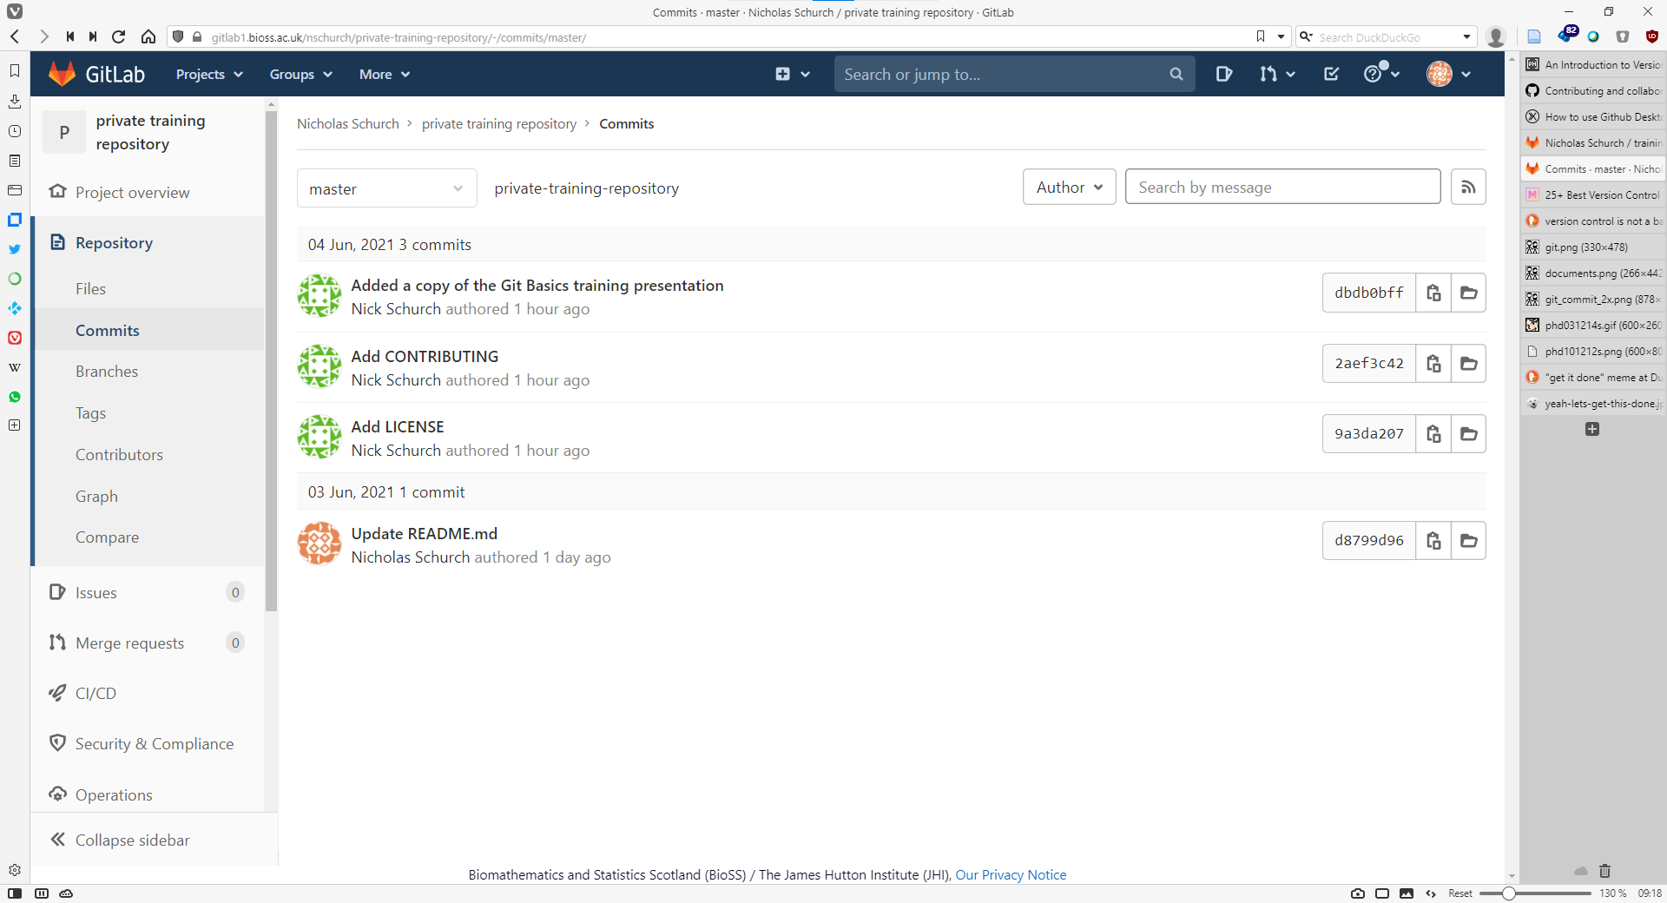
3. GitLab Repository history
list of commits
click to see details

Slide 20
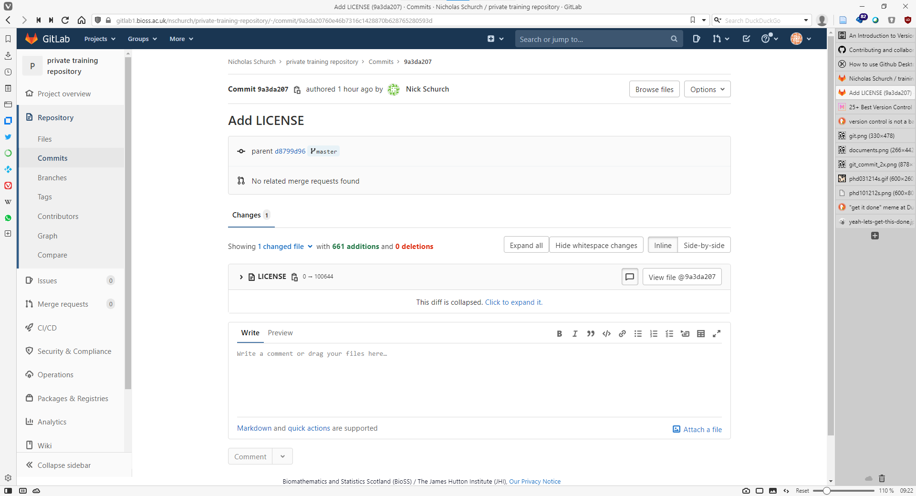
3. GitLab Repository history
details of this commit: who, unique id, when
click to see detail of this specific change
list of changes in this commit

Slide 21
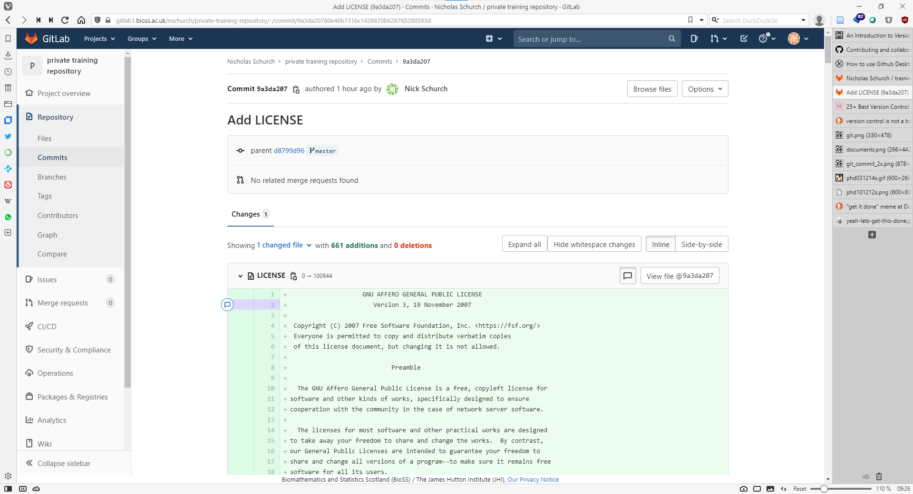
3. GitLab Repository history

Slide 22
3. Is there anything new in your local repository?
$ git status
On branch master
Your branch is up to date with 'origin/master'.
nothing to commit, working tree clean
$

Slide 23
3. Is there anything new in the GitLab repository?
$ git status
On branch master
Your branch is up to date with 'origin/master'.
nothing to commit, working tree clean
$
$ git fetch
remote: Enumerating objects: 5, done.
remote: Counting objects: 100% (5/5), done.
remote: Compressing objects: 100% (2/2), done.
remote: Total 3 (delta 1), reused 0 (delta 0), pack-reused 0
Unpacking objects: 100% (3/3), 291 bytes | 15.00 KiB/s, done.
From gitlab1.bioss.ac.uk:nschurch/private-training-repository
c7334d4..55d0e2c master -> origin/master
$
$ git status
On branch master
Your branch is behind 'origin/master' by 1 commit, and can be fast-forwarded.
(use "git pull" to update your local branch)
nothing to commit, working tree clean
$
Notes:
Git status only tells you about new local changes.
To compare your local repo to the current remote repo to look for changes on the remote, first use git fetch
Then git status will tell us about the differences

Slide 25
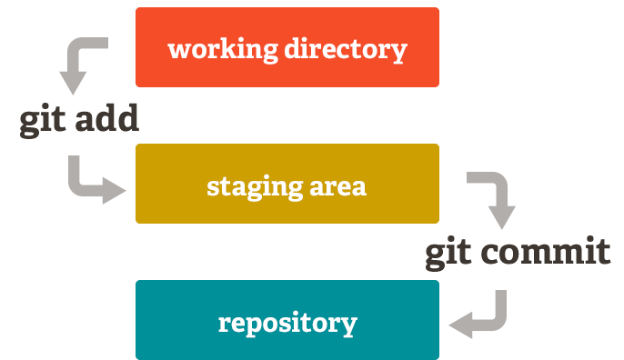
4. Commit changes
Glossary
repository | set of files/directories under version control
clone | make a local copy of a GitLab repository
fetch / status / show / log | get info about your repository, and compare to the GitLab version
add | add changes to the staging list
commit | locally store a set of repository changes
push | upload changes from the local repository version to GitLab
pull | download changes from the GitLab repository to your local repository
remove | remove a local file & remove it from local version control
clean | remove any local untracked files
reset | restore the local repository to a particular version
conflict | local and GitLab changes to the same file(s)! Help!
Notes:
Version control knows we have made changes – but hasn’t stored those changes in the history yet.
Commit adds those changes to the version history (usually with a message saying what the changes represent and why).
Many edits and saves can be done in between committed changes. Don’t have to commit every little change.
Commits should represent a set of changes with a single purpose.
No diff for binary files.
Remove deletes the file and removes it from version control (got rm –cached to remove it just from version control, but not delete the file.)
Reset removes all untracked files and any uncommitted changes
Yes, you can reset to a later commit if you need too, but that’s more complicated….

Slide 26
4. Commit changes
Glossary
repository | set of files/directories under version control
clone | make a local copy of a GitLab repository
fetch / status / show / log | get info about your repository, and compare to the GitLab version
add | add changes to the staging list
commit | locally store a set of repository changes
push | upload changes from the local repository version to GitLab
pull | download changes from the GitLab repository to your local repository
remove | remove a local file & remove it from local version control
clean | remove any local untracked files
reset | restore the local repository to a particular version
conflict | local and GitLab changes to the same file(s)! Help!
myfile.txt
myfile.txt
myfile.txt
myfile.txt
edit a file
.git
v1
.git
v1
.git
v1
.git
v2
edit myfile.txt
add changes to staging area
commit changes to the history
repository
file under version control
Hidden directory with all version control info in
add changes to staging area
commit changes to the history
add mypic.jpg
myfile.txt
myfile.txt
myfile.txt
myfile.txt
add a file
.git
v1
.git
v1
.git
v1
.git
mypic.jpg
mypic.jpg
mypic.jpg
v2
Notes:
Version control knows we have made changes – but hasn’t stored those changes in the history yet.
Commit adds those changes to the version history (usually with a message saying what the changes represent and why).
Many edits and saves can be done in between committed changes. Don’t have to commit every little change.
Commits should represent a set of changes with a single purpose.
No diff for binary files.
Remove deletes the file and removes it from version control (got rm –cached to remove it just from version control, but not delete the file.)
Reset removes all untracked files and any uncommitted changes
Yes, you can reset to a later commit if you need too, but that’s more complicated….

Slide 27
4. Commit changes
$ echo "Hello World!" > newfile.txt
$
$ git status
On branch master
Your branch is up to date with 'origin/master'.
Untracked files:
(use "git add <file>..." to include in what will be committed)
newfile.txt
nothing added to commit but untracked files present (use "git add" to track)
$

Slide 28
4. Commit changes
Could also use git add --all to stage all changes
$ git add <file>
$
$ git add newfile.txt
$
$ git status
On branch master
Your branch is up to date with 'origin/master'.
Changes to be committed:
(use "git restore --staged <file>..." to unstage)
new file: newfile.txt
$

Slide 29
4. Commit changes
$ git commit -m "Added new file.“
[master 909fda6] Added new file.
1 file changed, 1 insertion(+)
create mode 100644 newfile.txt
$
$ git status
On branch master
Your branch is ahead of 'origin/master' by 1 commit.
(use "git push" to publish your local commits)
nothing to commit, working tree clean
$
Notification that your local repository is ahead of the remote

Slide 30
5. Push local changes up to GitLab
Glossary
repository | set of files/directories under version control
clone | make a local copy of a GitLab repository
fetch / status / show / log | get info about your repository, and compare to the GitLab version
add | add changes to the staging list
commit | locally store a set of repository changes
push | upload changes from the local repository version to GitLab
pull | download changes from the GitLab repository to your local repository
remove | remove a local file & remove it from local version control
clean | remove any local untracked files
reset | restore the local repository to a particular version
conflict | local and GitLab changes to the same file(s)! Help!
myfile.txt
myfile.txt
v1
mypic.jpg
v2
Remote
Local
push
myfile.txt
mypic.jpg
.git
v2

Slide 31
5. Push local changes to GitLab
$ git push
Enumerating objects: 4, done.
Counting objects: 100% (4/4), done.
Delta compression using up to 12 threads
Compressing objects: 100% (2/2), done.
Writing objects: 100% (3/3), 295 bytes | 147.00 KiB/s, done.
Total 3 (delta 1), reused 0 (delta 0), pack-reused 0
To gitlab1.bioss.ac.uk:nschurch/private-training-repository.git
dbdb0bf..909fda6 master -> master
$
$ git status
On branch master
Your branch is up to date with 'origin/master'.
nothing to commit, working tree clean
$

Slide 33
6. Collaborative Projects
GitLab facilitates collaboration
Collaborators clone individual copies of the GitLab repository
myfile.txt
mypic.jpg
Remote
v2
Alice
Bob
Charlie
myfile.txt
myfile.txt
myfile.txt
mypic.jpg
mypic.jpg
mypic.jpg
.git
.git
.git
v2
v2
v2
Local
Local
Local

Slide 34
6. Collaborative Projects
myfile.txt
GitLab facilitates collaboration
Collaborators clone individual copies of the GitLab repository
Collaborators make changes locally
If changes exist in the remote that you don’t have yet:
cannot push to the remote
pull, to integrate remote changes
myfile.txt
mypic.jpg
mypic.jpg
Remote
v2
v3
Alice
Bob
Charlie
myfile.txt
myfile.txt
myfile.txt
mypic.jpg
mypic.jpg
mypic.jpg
.git
.git
Paper.docx
v3
v3
Local
Local
.git
v3
Local
Notes:
More on resolving conflicts another time.

Slide 35
6. Pull changes from GitLab
Glossary
repository | set of files/directories under version control
clone | make a local copy of a GitLab repository
fetch / status / show / log | get info about your repository, and compare to the GitLab version
add | add changes to the staging list
commit | locally store a set of repository changes
push | upload changes from the local repository version to GitLab
pull | download changes from the GitLab repository to your local repository
remove | remove a local file & remove it from local version control
clean | remove any local untracked files
reset | restore the local repository to a particular version
conflict | local and GitLab changes to the same file(s)! Help!
myfile.txt
mypic.jpg
myfile.txt
v1
Paper.docx
v3
Remote
pull
Local
myfile.txt
myfile.txt
mypic.jpg
mypic.jpg
.git
Paper.docx
v2
.git
v3

Slide 36
6. Pull local changes to GitLab
$ git pull
remote: Enumerating objects: 6, done.
remote: Counting objects: 100% (6/6), done.
remote: Compressing objects: 100% (3/3), done.
remote: Total 4 (delta 2), reused 0 (delta 0), pack-reused 0
Unpacking objects: 100% (4/4), 439 bytes | 16.00 KiB/s, done.
From gitlab1.bioss.ac.uk:nschurch/private-training-repository
909fda6..c7334d4 master -> origin/master
Updating 909fda6..c7334d4
Fast-forward
README.md | 2 +-
1 file changed, 1 insertion(+), 1 deletion(-)
$

Slide 37
6. Collaborative Projects
myfile.txt
GitLab facilitates collaboration
Collaborators clone individual copies of the GitLab repository
Collaborators make changes locally
If changes exist in the remote that you don’t have yet:
Cannot push to the remote
pull, to integrate remote changes
resolve any conflicts
then push to the remote
myfile.txt
mypic.jpg
mypic.jpg
Remote
v3
v4
pull
push
Alice
Bob
Bob
Charlie
myfile.txt
myfile.txt
myfile.txt
myfile.txt
mypic.jpg
mypic.jpg
mypic.jpg
mypic.jpg
.git
.git
.git
Paper.docx
v3
v3
v4
Local
Local
.git
Local
v3
Local
Notes:
More on resolving conflicts another time.

Slide 38
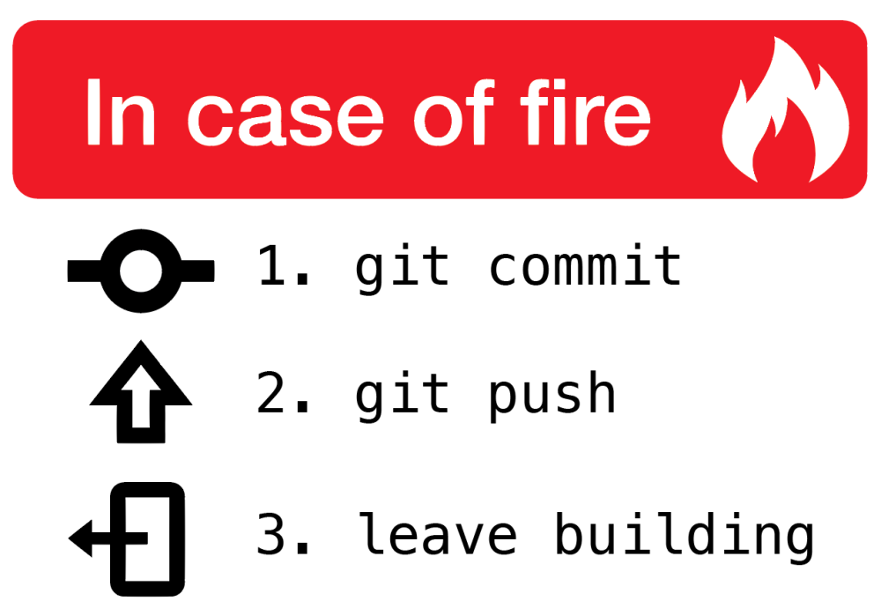
7. Task: collaborator contribution (20 min)
Clone the repository https://gitlab1.bioss.ac.uk/davidn/websitecasestudies.git
Write a text/markdown file with a two paragraph ‘highlight’ about a piece of your own work to the ‘highlights’ directory from the repository.
Stage and commit the changes with a comment.
Push the changes to GitLab.
Pull from the repository once everyone has finished.
High fives all round!

Slide 40
Spare Slides – mostly GitHub Desktop focussed

Slide 41
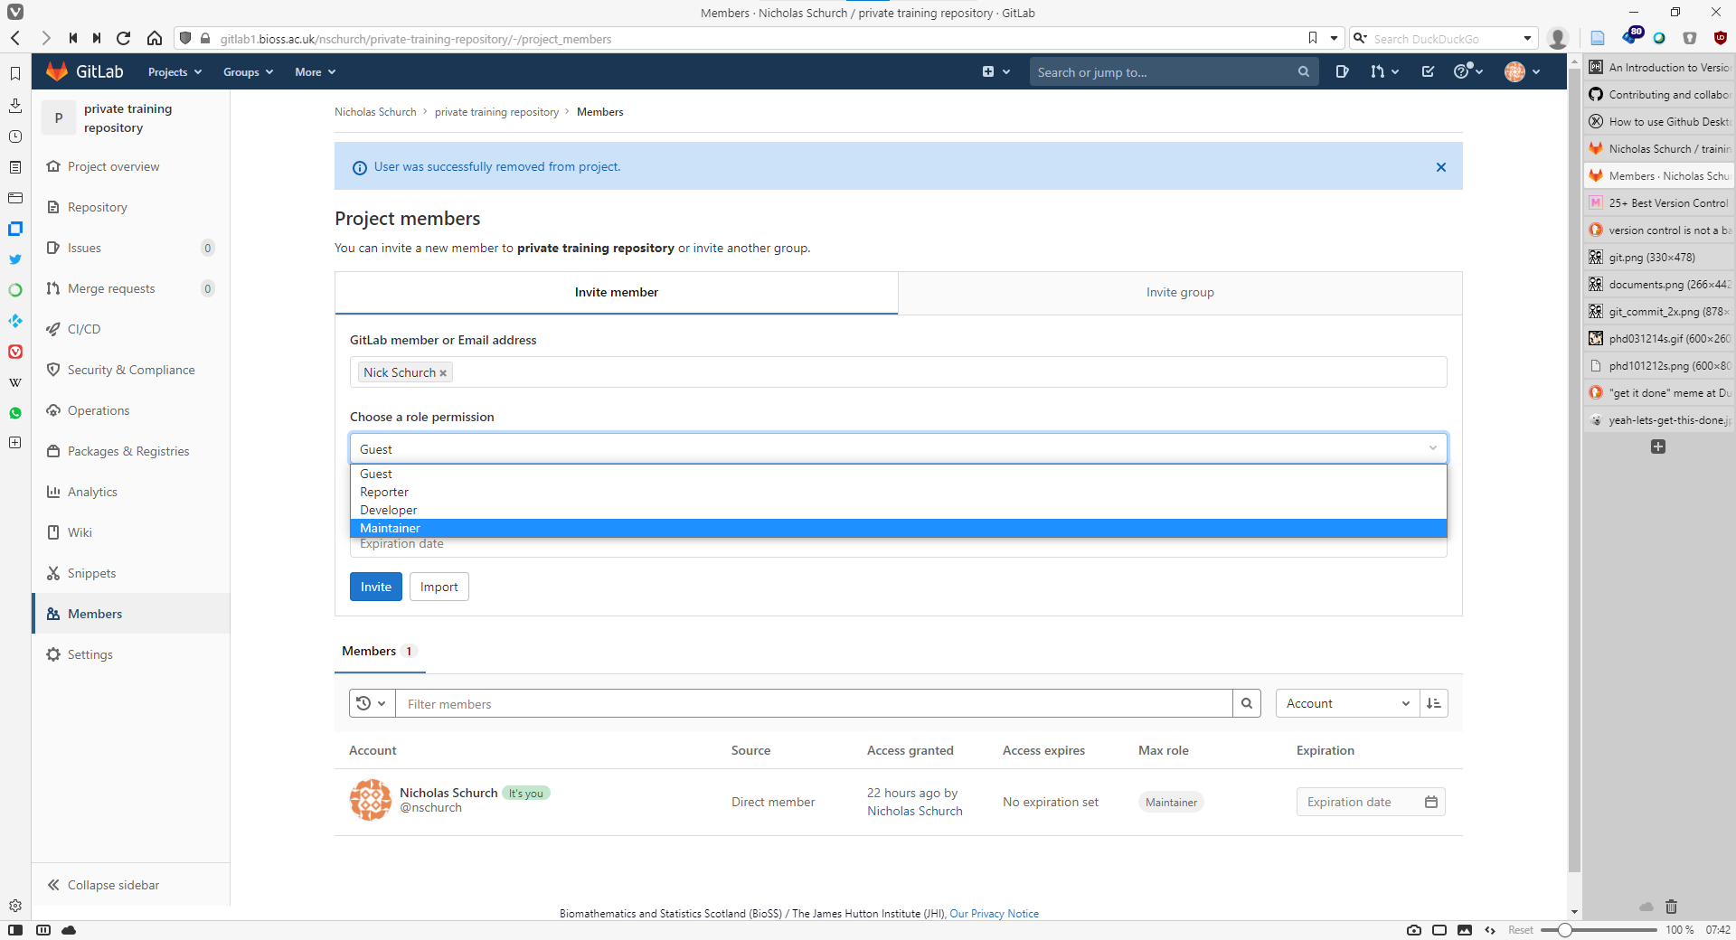
Adding a collaborator
choose a role, this controls their permissions:
guest = view only
reporter = guest + manage
developer = reporter + edit
maintainer = all
start typing here to find your collaborator
click here
click here

Slide 42
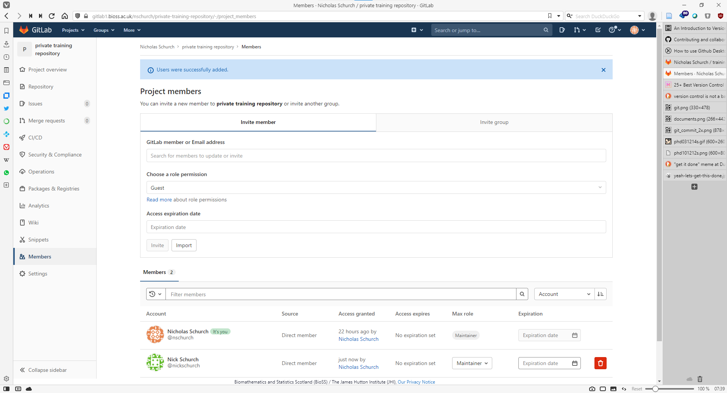
Adding a collaborator
success!

Slide 43
How version control works: basics
Glossary
repository | set of files/directories under version control
init | Initialize local version control repository
add | add untracked changes to stage
commit | store a set of repository changes
remove | remove a file & remove it from version control
clean | remove any untracked files
reset | restore the repository to a particular version
myfile.txt
myfile.txt
myfile.txt
create a binary file
.git
v1
.git
v1
.git
v2
edit myfile.txt
Add, then
commit changes
Initialise repository
file under version control
myfile.txt
myfile.txt
myfile.txt
myfile.txt
Hidden directory with all version control info in.
.git
.git
.git
commit changes
.git
v2
mypic.jpg
mypic.jpg
mypic.jpg
mypic.jpg
v3
v3
v2
remove myfile.txt
commit changes
Add the file to version control
.git
myfile.txt
myfile.txt
myfile.txt
mypic.jpg
v4
.git
v2
.git
v2
.git
v5
reset to v2
Edit myfile.txt
commit
Notes:
Version control knows we have made changes – but hasn’t stored those changes in the history yet.
Commit adds those changes to the version history (usually with a message saying what the changes represent and why).
Many edits and saves can be done in between committed changes. Don’t have to commit every little change.
Commits should represent a set of changes with a single purpose.
No diff for binary files.
Remove deletes the file and removes it from version control (got rm –cached to remove it just from version control, but not delete the file.)
Reset removes all untracked files and any uncommitted changes
Yes, you can reset to a later commit if you need too, but that’s more complicated….

Slide 44
How git works with GitHub
Glossary
repository | set of files/directories under version control.
init | Initialize local version control repository
commit | store a set of repository changes.
add | add untracked files to version control.
remove | remove a file & remove it from version control.
clean | remove any untracked files.
reset | restore the repository to a particular version.
clone | make a local copy of a GitHub repository.
push | upload a changes from a local repository version to GitHub.
Pull | Download changed from a GitHub repository to your local copy
README.md
README.md
README.md
external push
.gitignore
.gitignore
.gitignore
LICENSE
LICENSE
LICENSE
.git
v1
.git
.git
myfile.txt
newfile.txt
v2
v3
clone
push
pull
README.md
README.md
README.md
.gitignore
.gitignore
.gitignore
create, add & commit
LICENSE
LICENSE
LICENSE
.git
v1
.git
.git
myfile.txt
newfile.txt
v2
v3
Notes:
Below the line = local git repository, above the line = Github cloud repository.
Point here is to emphasis new terminology.

Slide 45
How does it work with GitHub then….
Glossary
repository | set of files/directories under version control.
init | Initialize local version control repository
commit | store a set of repository changes.
add | add untracked files to version control.
remove | remove a file & remove it from version control.
clean | remove any untracked files.
reset | restore the repository to a particular version.
clone | make a local copy of a GitHub repository.
push | upload a changes from a local repository version to GitHub.
pull | Download changed from a GitHub repository to your local copy
merge | Integrate local and GitHub changes.
README.md
README.md
external push
.gitignore
.gitignore
LICENSE
LICENSE
.git
.git
newfile.txt
v3
newfile.txt
v4a
pull & merge
README.md
README.md
README.md
.gitignore
.gitignore
.gitignore
edit & commit
LICENSE
LICENSE
LICENSE
.git
.git
.git
newfile.txt
v3
newfile.txt
v4b
newfile.txt
v5

Slide 46
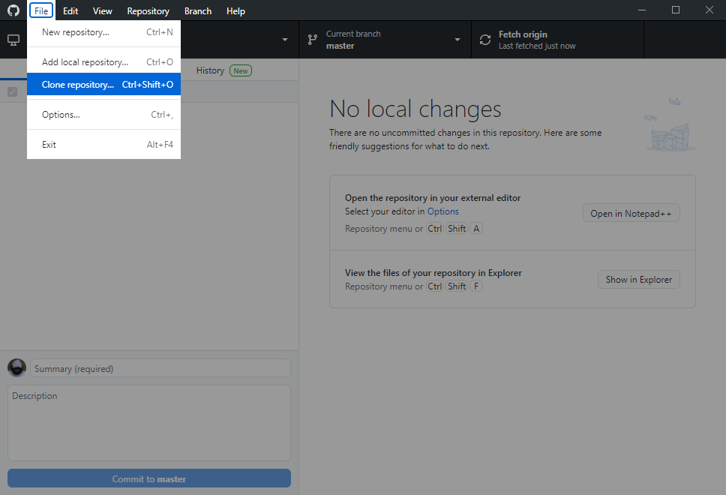
Cloning the GitLab repository
GitHub Desktop
click this

Slide 47
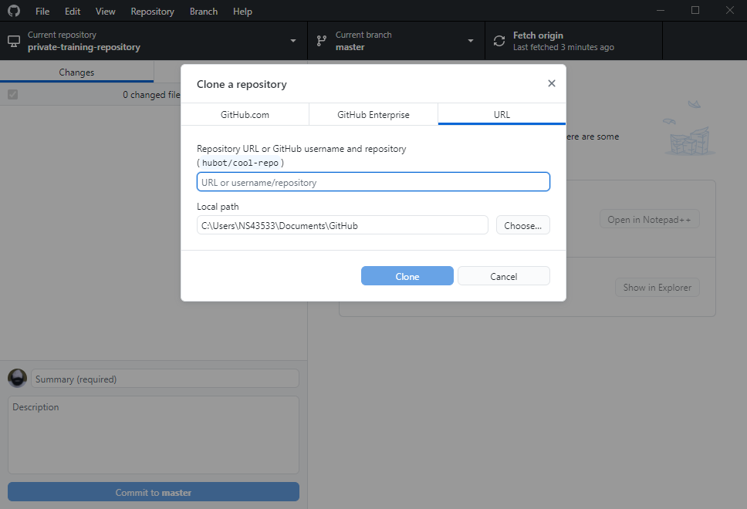
Cloning the GitLab repository
URL to clone the repository from
click this
local repository path

Slide 48
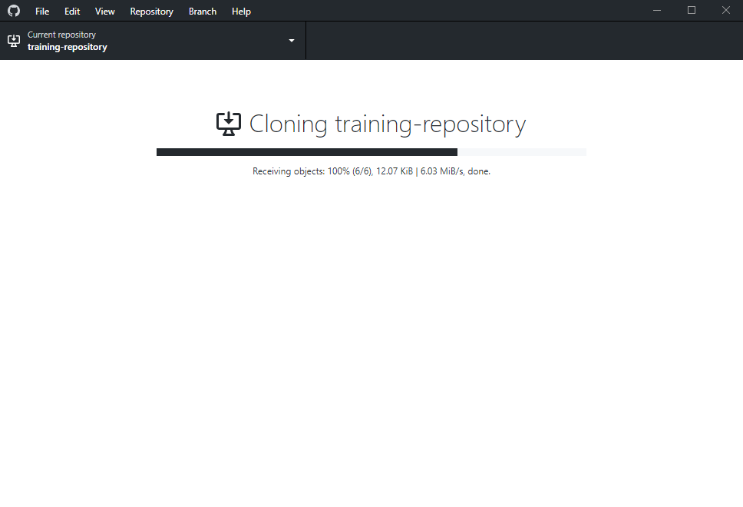
Cloning the GitLab repository
If you chose ‘private’ or ‘internal’ as your repository visibility you’ll be prompted for:
GitLab username
GitLab password

Slide 49
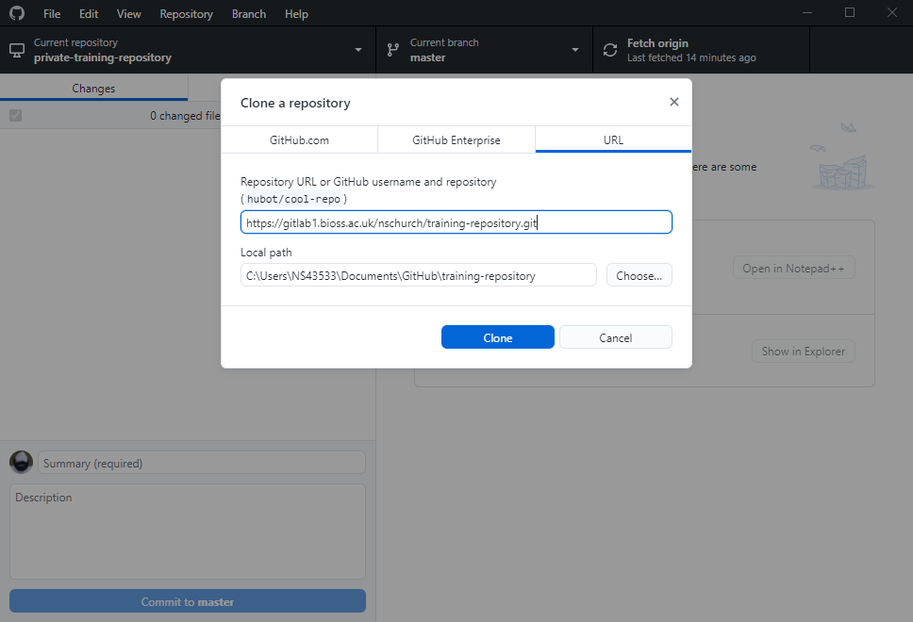
Cloning the GitLab repository
updated path
paste here
click here

Slide 50
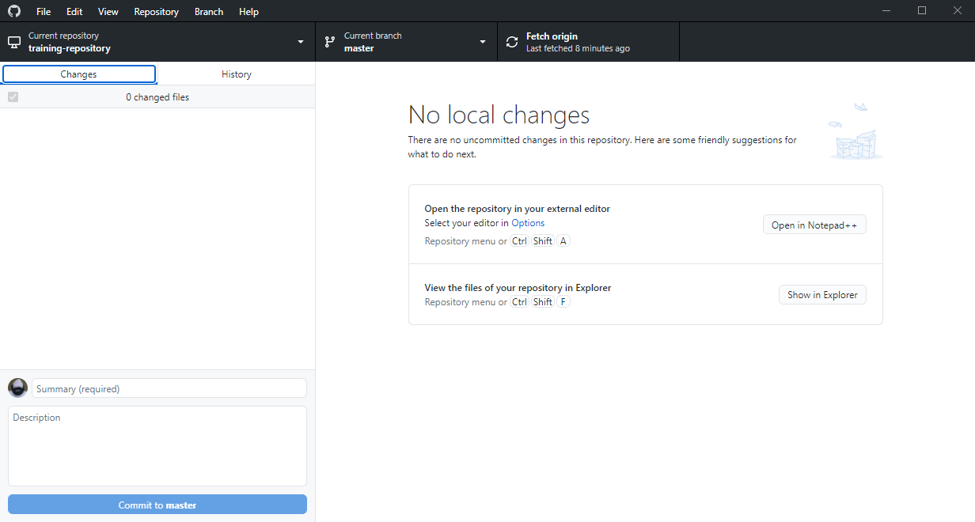
Cloning the GitLab repository
repository name
branch
current/last action
checkbox list of files with uncommitted changes
click this
Summary of changes for selected file (or ‘helpful’ suggestions)

Slide 51
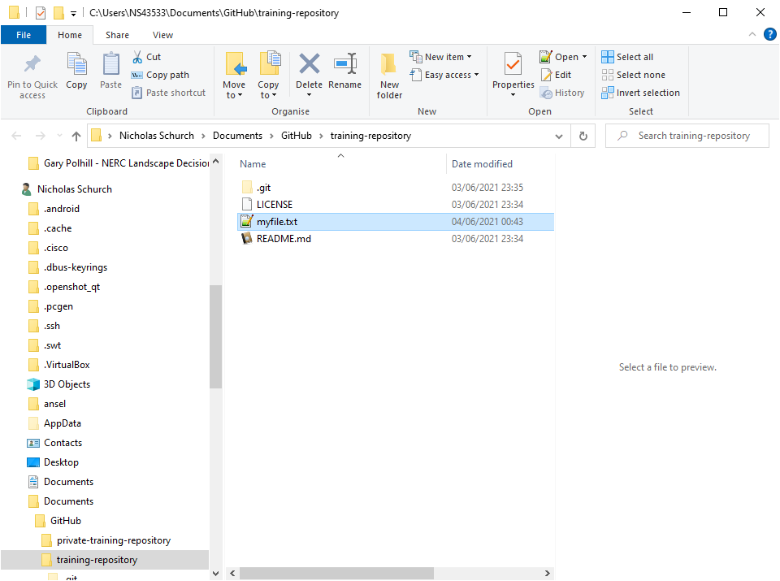
Commit changes
add a new file to your repository

Slide 52
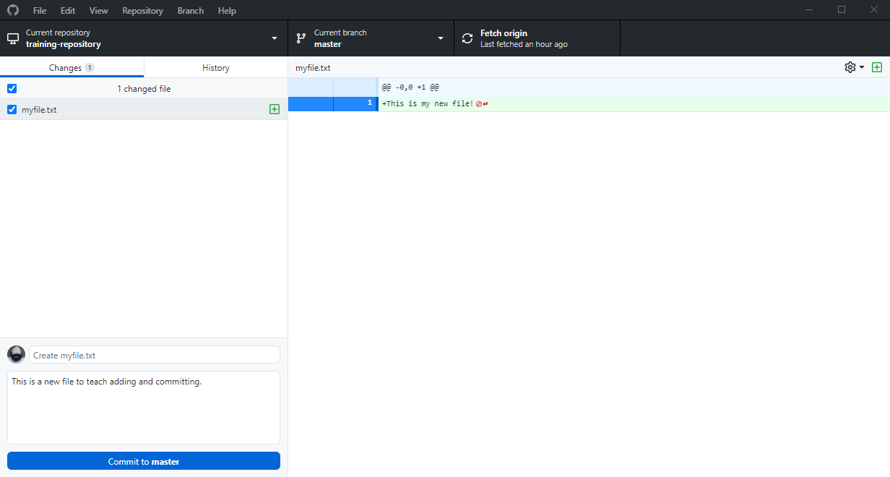
Commit changes
Autodetected files with uncommitted changes
Tick indicates file will be included in the commit (staged)
Summary of changes for selected file
Important rule: every commit must have a comment with it!
add a commit comment in here
click this

Slide 53
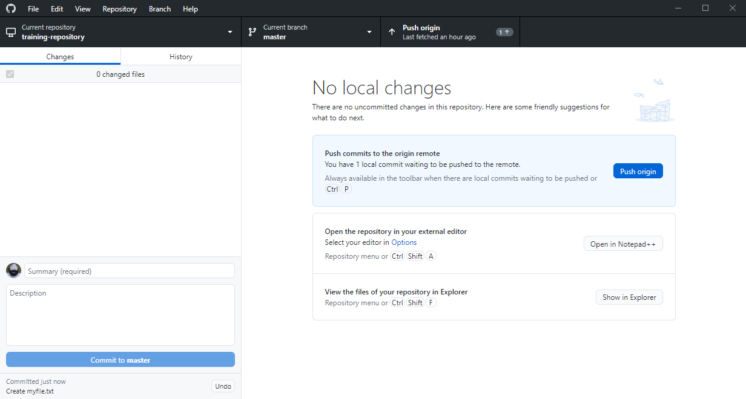
Push local changes to GitLab
click here
No more local changes
Notification that your local repository is ahead of the remote

Slide 54
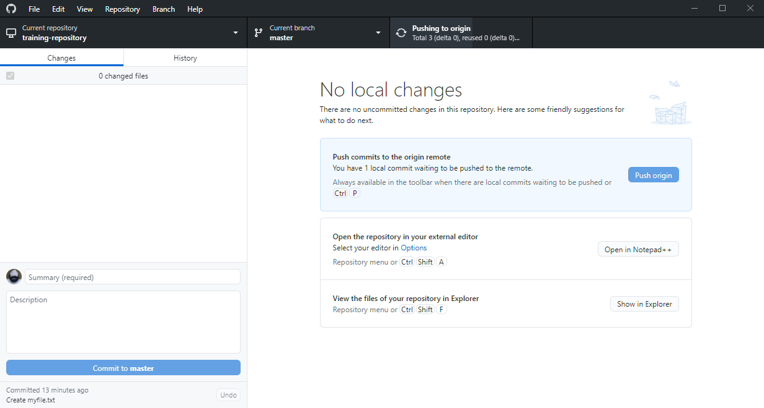
Push local changes to GitLab
Current push action

Slide 55
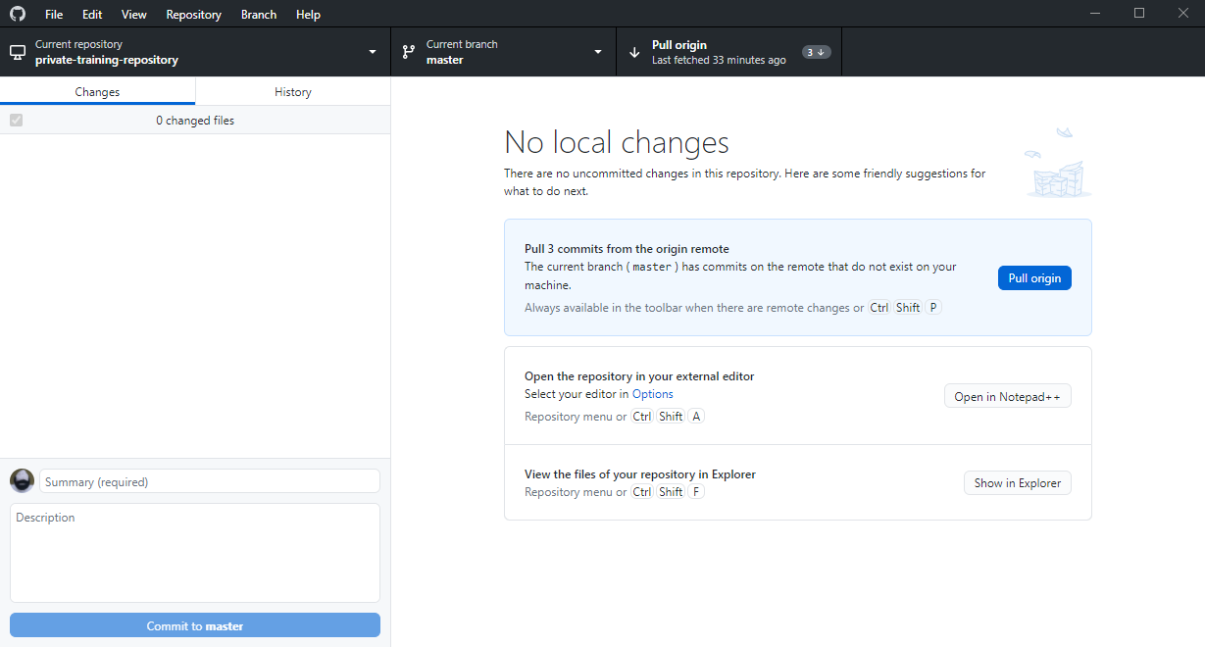
Fetch changes from GitLab
check here
changes should be autodetected
if not, click ‘Fetch origin’
same as ‘git status’ on the command line

Slide 56
Pull changes from GitLab
click here

Slide 57
Repository history
click here

Slide 58
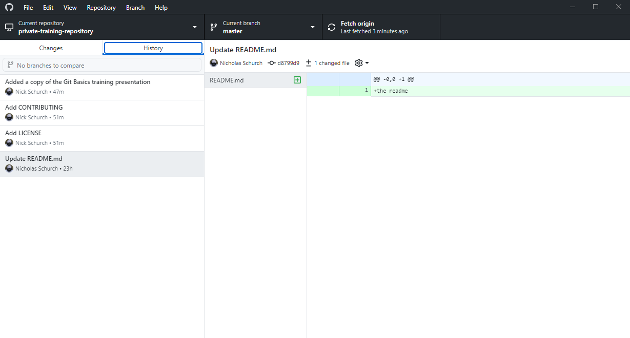
Repository history
details of this commit: who, unique id, summary
list of changes in this commit
detail of this specific change
list of all commits, who made them, and when

Slide 59
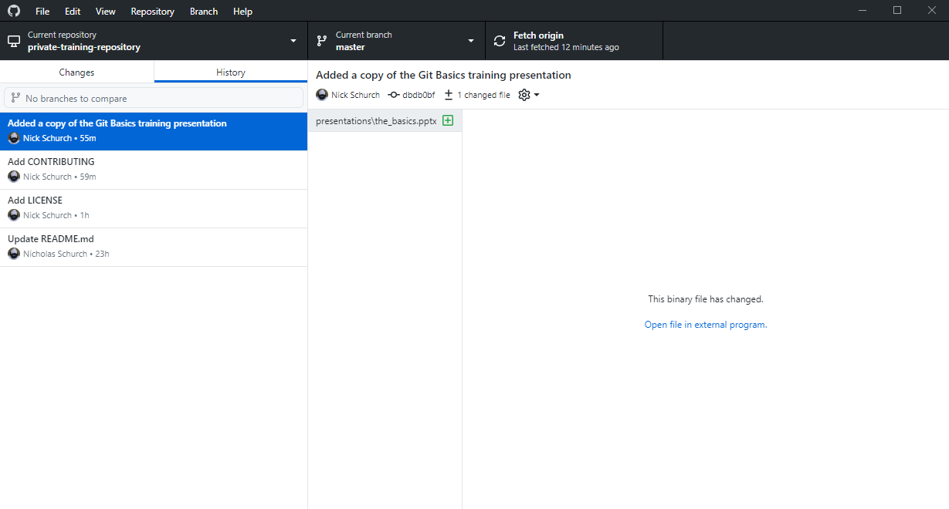
Repository history
far less information for non-text files (e.g. word, excel, pictures, presentations)

